Slide 1
College Enrollment, Graduation, & Employment
Aparna, Brandi and Carter

Slide 2

Motivation and Summary
Goal:
Our project goal is to compare enrollment and completion rates to employment in the US over time.
Key Questions:
Is there a relation between unemployment rate and enrollment or completion rates?
As employment rates decrease, do enrollment rates increase in response?
Can we predict enrollment rates based on current economic trends?
Answers:
We were able to visualize a correlation between enrollment and unemployment rates over time.
Similarly, we’re able to see a relationship between enrollment and completion rates.
We would need more data than what is available to determine cause-and-effect relationship and/or a predictive trend.

Slide 3


Questions & Data
Based on our questions, what types of data do we need to locate?
Economic data, including unemployment rates
Educational data, including enrollment and completion trends
Data Sources:
National Center for Educational Statistics
Federal Reserve Economic Data

Slide 4

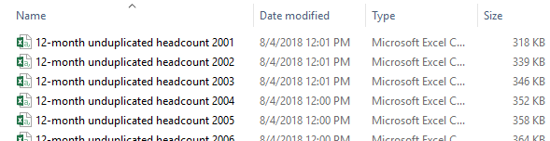
Data Cleanup & Exploration - NCES
NCES Exploration
Many different ways to pinpoint your data needs
User-friendly site, when you know exactly what you need
NCES Data Files Obtained
Separate enrollment files per year (2001-2017)
Separate completion (a.k.a., degrees awarded) files per year
(2001-2017 for enrollment, 2005-2017 for completions)
Merged using “copy*combine.csv” command line
Cleanup
Removed extraneous columns
Removed rows with missing data
Problems
Many holes in the completion data

Slide 5
Data Analysis
* Discuss the steps you took to analyze the data and answer each question you asked in your proposal * Present and discuss interesting figures developed during analysis, ideally with the help of Jupyter Notebook
CHARTS GO HERE ☺

Slide 6
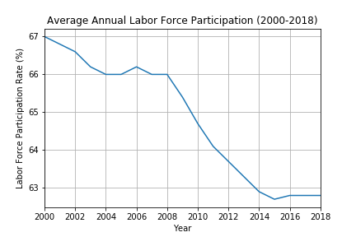
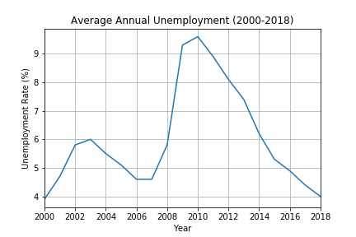
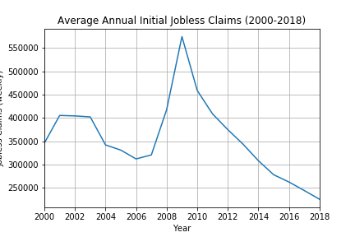

Slide 7
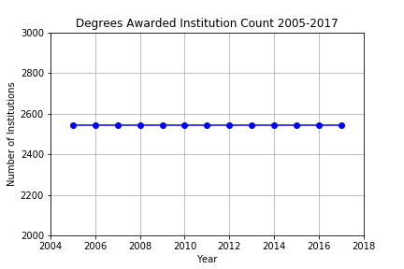
Degree Completion
Degree Completion data contains data for FOUR Degree Types from 2,544 institution (2005-2017):
One year certification
Two year certification
Associates Degree
Bachelor’s Degree

Slide 8
Data Frame was processed with
Remove unwanted columns
Rename, re-arrange columns
Convert empty cells to ‘0’; do not delete!
Add up sum of degrees per year with .groupby function
Created summary table with total degree per year per Degree type with Pandas dictionary
CompletionPerYear = pd.DataFrame({"Shorter Certificates":df5,
"Longer Certificates": df6,
"Associates Degree": df7,
"Bachelors Degree" : df8})
Total degree awarded per year = Add all 4 degrees awarded year
Plotting
Notes:
We removed the column for Master’s degree awarded since it is not in our scope.

Slide 9
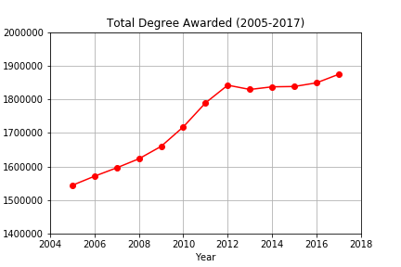
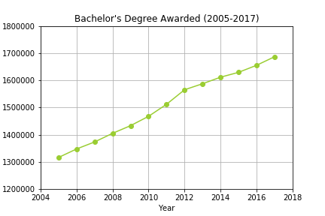
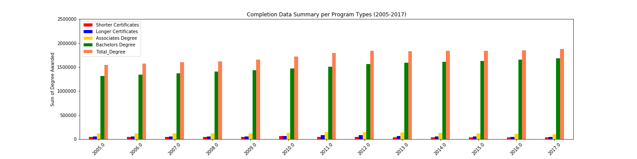
Summary of Degrees Awarded
On average ~87% of total graduates had Bachelor's Degree

Slide 10
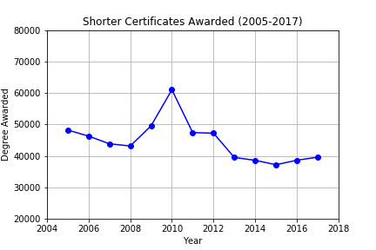
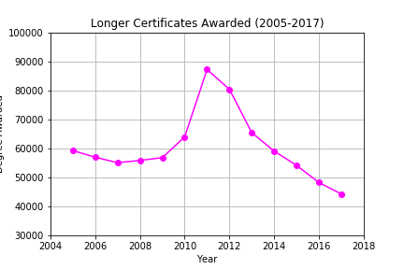
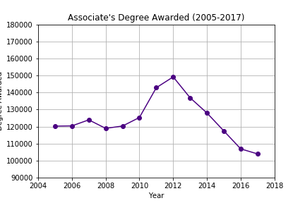
Trend in Degrees Awarded
Increase in short term degrees with increase in unemployment rate

Slide 11
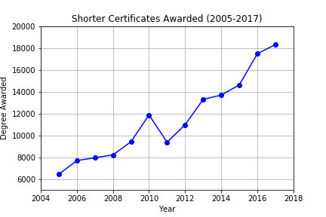
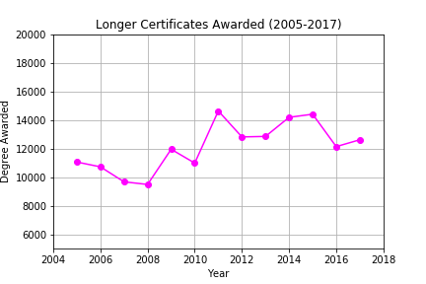
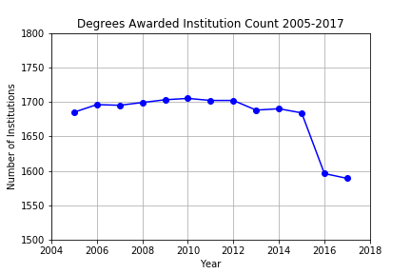
.dropna function to delete empty cells
*Deleting empty cells with .dropna function in a multicolumn data frame causes mis-representation of data.
*With .dropna, deleted ~11,000 rows!
*Convert NaN to ‘0’ value instead.
Notes:
Use to covert NaN to ‘0’:
df.fillna(value=0)

Slide 12
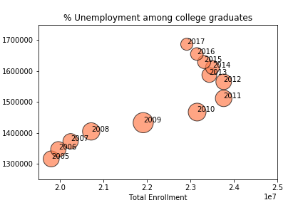

Slide 13
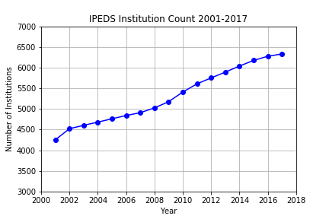
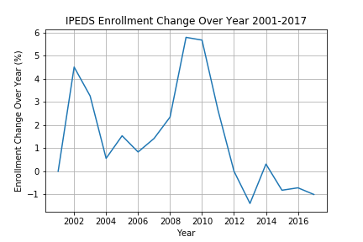

Slide 14
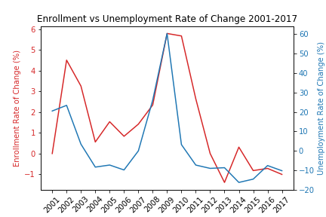
Discussion
* Discuss your findings. Did you find what you expected to find? If not, why not? What inferences or general conclusions can you draw from your analysis?

Slide 15
Post Mortem
* Discuss any difficulties that arose, and how you dealt with them * Discuss any additional questions that came up, but which you didn't have time to answer: What would you research next, if you had two more weeks?

Slide 16
Questions
* Open-floor Q&A with the audience

